Slide 1
JS Test Basic
Anthony Chen
2016-10-18

Slide 2


Slide 3
Hello world – Assert (chaijs.com/api/assert/)
var assert = require('chai').assert; describe("Array", function() { describe("#indexOf()", function() { it("should return -1 when the value is not present",
function() { assert.equal(-1, [1,2,3].indexOf(4)); }); }); });

Slide 4
Benefit
Look like a computer expert
Look like extreme
Refuse legacy code -> Better code

Slide 5
Why people hate it?
Useless
Don’t know how to do it
Too much additional effort
Only QA’s responsibility

Slide 6
Agenda: Dream Testing Structure
Able to access each layer
Small function: Mocha
Service API: Mock http
Dom: Mocha in Browser
Component: React Component
Auto Browser: Phantom, Selenium
Continuous Integration (?)
Business behavior driven (?)

Slide 7
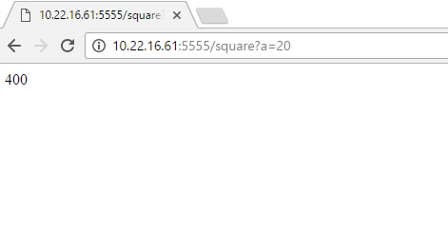
Async: Square Result
http://10.22.16.61:5555/square?a=20
node /d/doc/Dev/javascript-me/first-server/src/index-square.js

Slide 8
Mock: http
var events = require('events').EventEmitter; var util = require('util'); var myhttp = function () { this.statusCode = 200; var _this = this; this.get = function (options, callback) { callback(_this); return _this; }; }; util.inherits(myhttp, events);
D:\Doc\Dev\javascript-me\first-server\test\index-square-test-with-mock-http.js

Slide 9
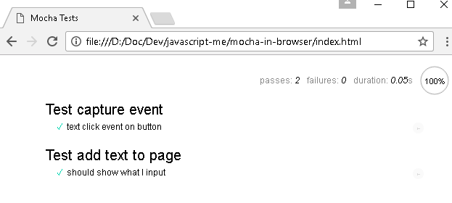
Mocha: Test DOM interaction in Browser
D:\Doc\Dev\javascript-me\mocha-in-browser\index.html

Slide 10
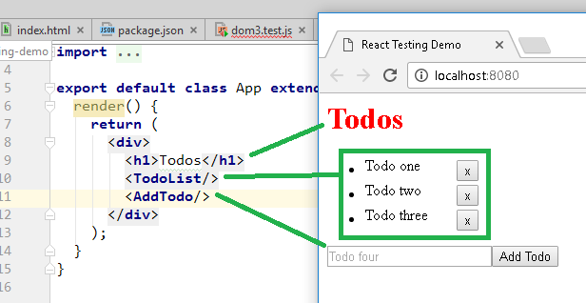
React (0)
cd /d/doc/Dev/javascript-me/react-testing-demo
npm start
npm test

Slide 11
React (1) - Simplified Redux?
const TodoStore = assign({}, EventEmitter.prototype, { items: { todos: [ { id: 0, name: 'Todo one', done: false }, { id: 1, name: 'Todo two', done: false }, { id: 2, name: 'Todo three', done: false }, ] },
…
}

Slide 12
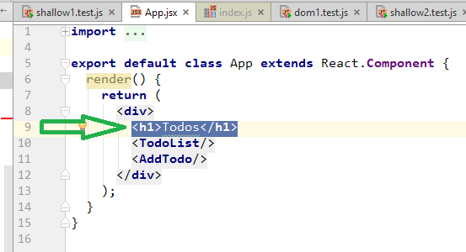
React (2) - Shallow Rendering 浅渲染
Only first layer is rendered (Debug). Fast.
Pass value
renderer.render(<Component {...props}/>);

Slide 13
React (3.1) - DOM Rendering 渲染到真实DOM
Mocking: window, document and navigator.
import jsdom from 'jsdom'; if (typeof document === 'undefined') { global.document = jsdom.jsdom(
'<!doctype html><html><body></body></html>'
); global.window = document.defaultView; global.navigator = global.window.navigator; }

Slide 14
React (3.2) - DOM Rendering 渲染到真实DOM
How to query specific DOM element?
import TestUtils from ‘react-addons-test-utils’; (Weak)
import {findDOMNode} from 'react-dom'; (Strong)
Simulate Click
TestUtils.Simulate.click(todoItem);

Slide 15
Drive Browser
Selenium vs. PhantomJS
3 Usages
Automatically open a production page in browser, do some interactions, do a screenshot.
Automatically open a production page in browser, do some interactions, fetch a value from web page and assert it in unit test.
Automatically open a fixture html page with unit test js files in browser, do some interactions, run these unit test and report the result.
Notes:
cd /d/Doc/Dev/lib/selenium java -jar selenium-server-standalone-3.0.0-beta3.jar
[1]
cd /d/doc/Dev/javascript-me/selenium-webdriver-test
node run-webdriverio-search-yahoo.js
[2]
cd /d/doc/Dev/javascript-me/selenium-webdriver-test
wdio wdio.conf.js
[3]
cd /d/doc/Dev/javascript-me/karma-seed
npm run test
npm run full-test

Slide 16
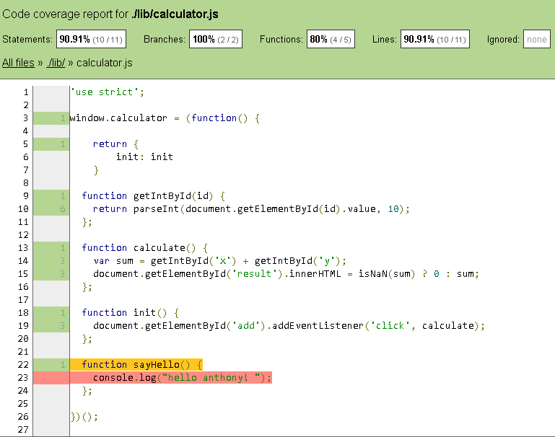
Code Coverage: karma and istanbul
Notes:
D:\Doc\Dev\javascript-me\karma-seed\coverage\Chrome 53.0.2785 (Windows 10 0.0.0)\index.html

Slide 17
Q & A
Preparation Curve
Self-study coding vs. Project coding

